Slide 1

RASSA: Resistive Pre-Alignment Accelerator for Approximate DNA Long Read Mapping
Silver medal winner in SC18 ACM Student Research Competition
Published in IEEE Micro, Jan-Feb 2019 issue
Roman Kaplan, Leonid Yavits and Ran Ginosar
Department of Electrical Engineering
Technion

Slide 2
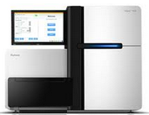

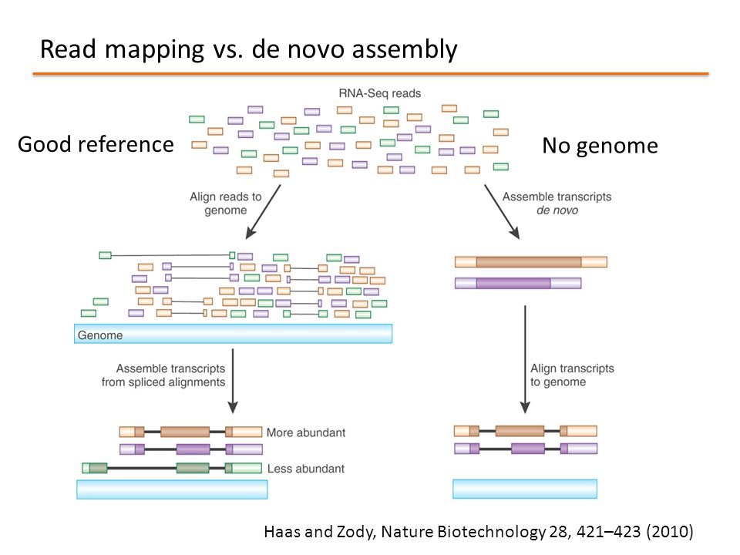
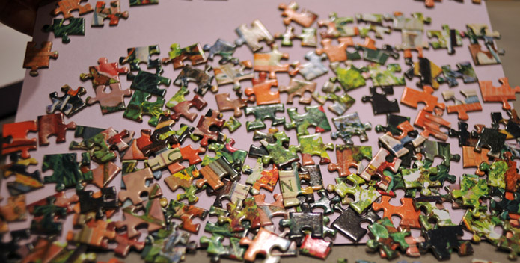
Motivation: Faster Genome Assembly
Sequencing machine
DNA
molecule
Many options exist once the genomic code is known:
Precision medicine: e.g., improved cancer treatment
Genetic risk factors detection
On-site disease detection
Assembling the genome is computationally difficult
→ Takes hours on a high-end machine
Sequencing
30-50x
DNA Reads
Reference
Exists
No Reference

Slide 3
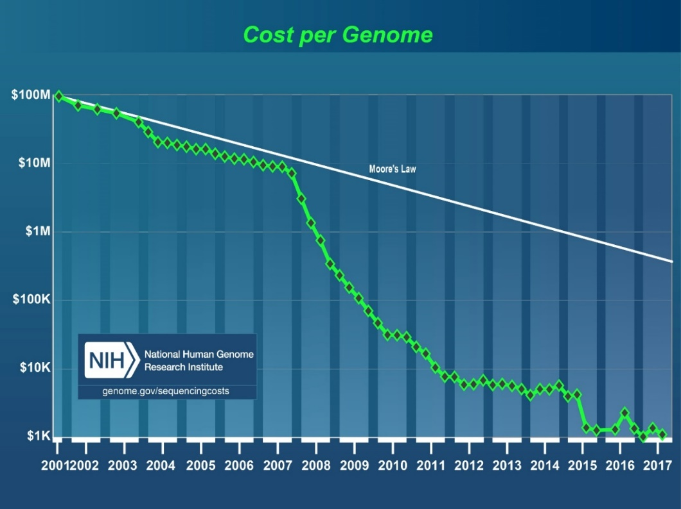
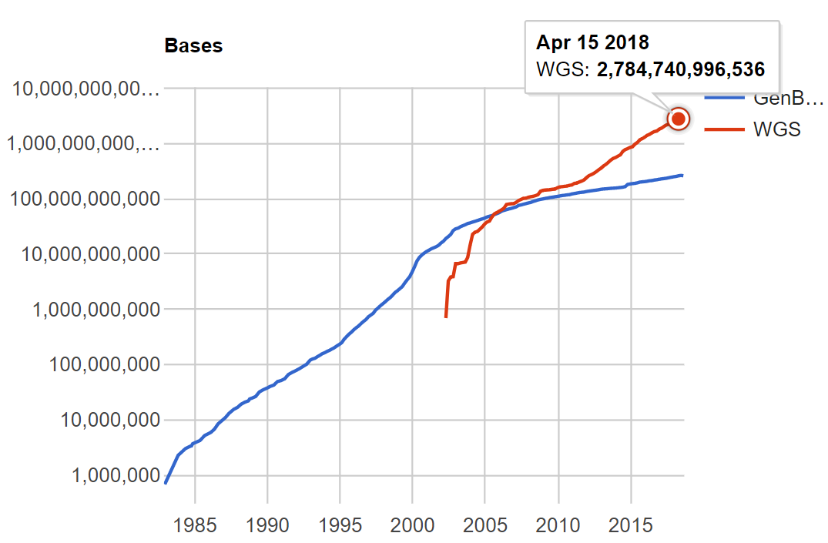
Why Bioinformatics Requires Acceleration?
Reduced costs ➔ Exponentially growing database sizes
Large samples: human genome=3Gbp. Sequencing requires ~30×
Even worse in other fields, like Metagenomics
GenBank
Whole-Genome Sequencing
10Tbp
1Tbp
Moore’s Law
100Gbp
10Gbp
Source: https://www.ncbi.nlm.nih.gov/genbank/statistics/

Slide 4
Problem: Long DNA Read Mapping
Major step in constructing a genome, when a reference sequence exists (e.g., human)
Informal Definition: Find the location of every sequenced read on the reference sequence
…
…
Reference Sequence
AGCTTAGCTCGCATAGCTCCCGAAATCGCTAAATGCGCCCTAGGCTAGCT
…
Mapping
…
GGGTTAACTCG
TAGCTCCCGAAATCGCTGAAT
GCACCAGACTAGCT
Sequenced Reads
AGCTCGCATAGCTCCCGAAA
AATGCGCCCTAGGCTAGCT
“Easier” with 1st (1970+) and 2nd (2000+) generation sequenced reads:
Low error rate (<1%)
Fixed-length, short reads: 100-600bp in length
2nd generation sequencing exists since the ~2000s → Many tools, heuristics and methods exist for short read mapping

Slide 5
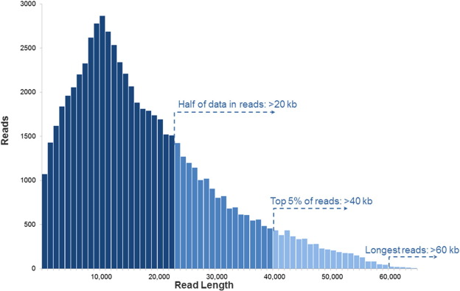
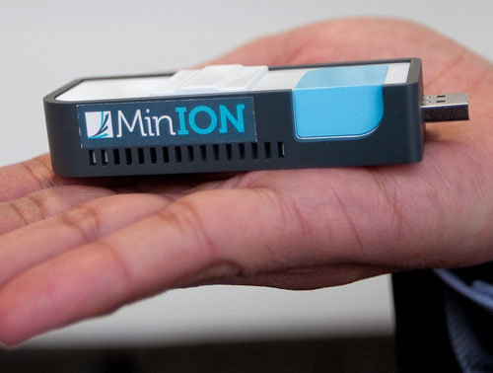
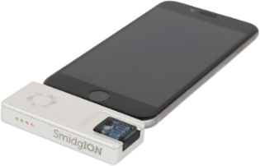
Problem: 3rd Generation of Sequencing Technologies
Challenges of 3rd generation sequencing (since 2010)
Reads are of varying long lengths: 1kbp-60kbp+
High error rates: ~15% for PacBio, ~20% for ONT
3rd generation continuous to develop
Error rates are reduced
New devices introduced
Constant search of mapping heuristics & high performance is difficult
PacBio Read Lengths Histogram
Existing read mapping tools do not work well when changing read characteristics
Sources: [right] Rhoads, Anthony, and Kin Fai Au. "PacBio sequencing and its applications." Genomics, proteomics & bioinformatics 13.5 (2015): 278-289.
[left] https://nanoporetech.com

Slide 6
Our Approach For Mapping Long Reads
1. Split the long reads to short fixed-length chunks
2. Use Hamming Distance with Sliding Window Search
→ Find location with high match score = low mismatch score
Read chunk
C C T A G T G A G C A T G A A C G T T C A C A G T G T C T G
Reference Sequence
(Stored on memory)
C A C T T C A C C T A A G T G A G C A T G A A T G T T C A C G T G T C T G C T G G C A T A C A G A G

Slide 7
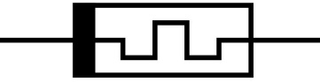
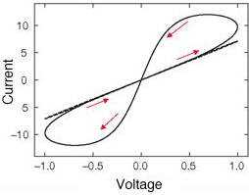
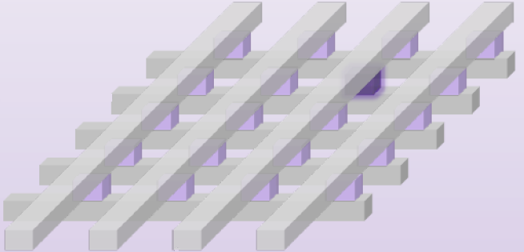
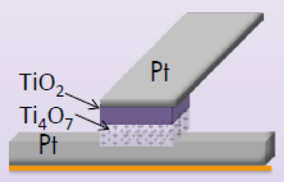
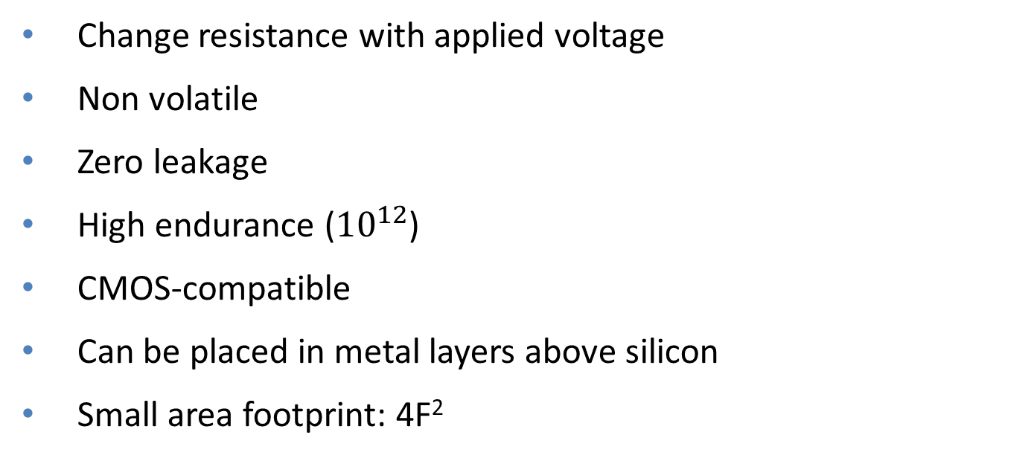
So What’s New? Memristors
Change resistance with applied voltage
Non volatile
Zero leakage
High endurance (${10}^{12}$)
CMOS-compatible
Can be placed in metal layers above silicon
Small area footprint: 4F²
Low
Resistance
High
Resistance

Slide 8
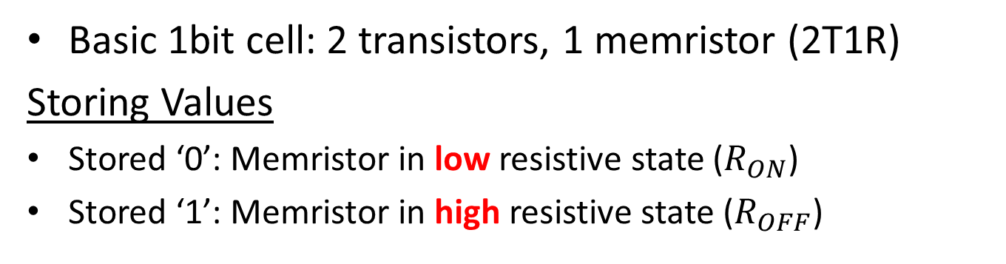
Architecture: The Basic 1Bit Cell
Compared pattern
(sequenced read)
Basic 1bit cell: 2 transistors, 1 memristor (2T1R)
Storing Values
Stored ‘0’: Memristor in low resistive state ($R_{ON}$)
Stored ‘1’: Memristor in high resistive state ($R_{OFF}$)
Stored value
Parasitic capacitance
Evaluation
Example: Stored ‘0’
Discharge before
evaluation starts
Compare to ‘1’: Mismatch
Compare to ‘0’: Match
Match line
Match line
Charge flow
➔ Match line voltage drop
No charge flow
➔ No change in Match line voltage
Selector ON
Selector OFF

Slide 9


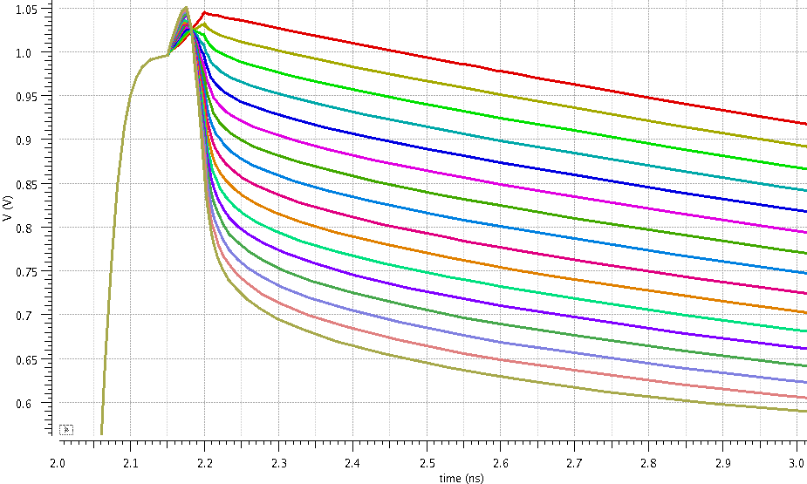
Architecture: Encoding DNA Bases and Counting Mismatches
One-hot encoding: 4 DNA bases → 4 bit cells per base
Match
Line
Match Line Voltage Level
0 mismatches
15 DNA bases (60 bit cells) share a Match Line
15 mismatches

Slide 10
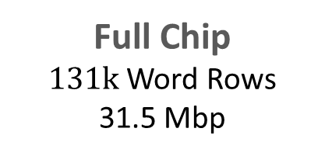
Architecture: Full Chip Design
Match Line voltage is decoded to a digital value: Analog-to-Digital converter
Lower Match Line voltage = mismatch (Match Line counts mismatches)
➔ Digital values in 4bit: from 0 to 15 mismatches (15 base pairs)
Full Chip
$131k$ Word Rows
31.5 Mbp
Sub-Word
15 bases × 4 bitcells
= 60 bitcells
Word Row
16 SubWords
(total 240 bases)
Word Row 131K
Sum
mismatches
Compare to
threshold

Slide 11
How it Works?
Compared long read
…
Chunk 1
Chunk 2
Reads are divided to fixed-size chunks: e.g., 200bp
A threshold is set to 40-50% of chunk’s length (determined empirically)
RASSA stores the reference sequence
Every chunk is compared against the entire reference
Map iteration: Compare chunk → Sum mismatches → ≤threshold ?
200 bps
200 bps
200bp
Chunk 1
Example comparison, cycle 1
Chunk Compared with the
Reference Sequence
The Comparison in RASSA
Reference Sequence
…
+
≤
Word Row 1
Compare chunk 1
Compare chunk 1
+
≤
Word Row 2
Chunk 1
Chunk 1
Chunk 1
+
Word Row 3
Compare chunk 1
≤
…
240bp
(Word Row)
240bp
(Word Row)
Word Row 131K

Slide 12
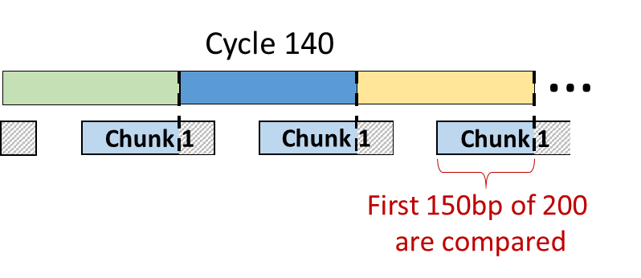
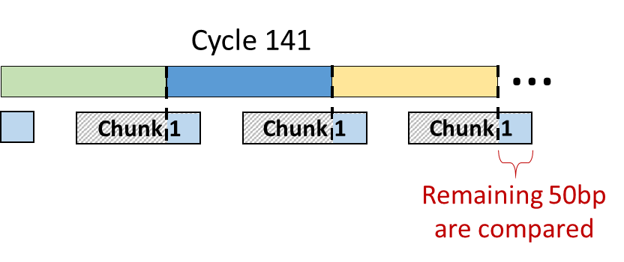
How it Works?
Full map iteration: shift chunk right → Compare → Sum → ≤threshold ?
Case: 2 Word Rows are needed to compare a chunk ➔ 2 cycles are needed per chunk
1st cycle: compare 1st part of chunk → sum all mismatches (no comparison to threshold)
2nd cycle: compare 2nd part of chunk → sum all misses + misses from 1st cycle → ≤threshold ?
Example: 2 cycles for mismatch count
200bp
Chunk Compared with Ref Seq
Next cycle
Current cycle
RASSA: Cycle 141
1
Chunk 1
RASSA: Cycle 140
Ref seq
+
≤
Word Row 1
Comp chunk 1
Word Row 2
Comp chunk 1
+
≤
Word Row 3
Comp chunk 1
+
≤
Word Row 4
…
Word Row 131K

Slide 13
How it Works?
Full map iteration: shift chunk right → Compare → Sum → ≤threshold ?
Case: 2 Word Rows are needed to compare a chunk ➔ 2 cycles are needed per chunk
1st cycle: compare 1st part of chunk → sum all mismatches (no comparison to threshold)
2nd cycle: compare 2nd part of chunk → sum all misses + misses from 1st cycle → ≤threshold ?
Example comparison, cycles 140-141
Chunk Compared with Ref Seq
RASSA: Cycle 141
Active
Inactive
Ref seq
1
Chunk
Ch. 1
+
≤
W R 2
Ch. 1
+
≤
W R 3
Ch. 1
+
≤
W R 4
…
Word Row 131K

Slide 14
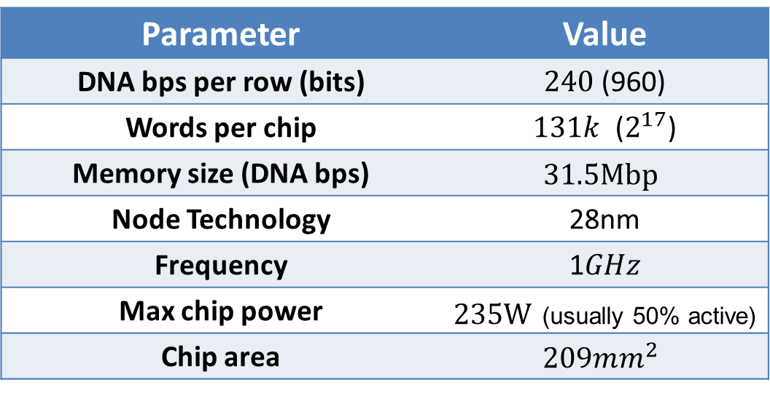
Full Chip Parameters
Sub-Word circuit designed, placed and routed using 28nm Global Foundries CMOS High-K Metal Gate library for:
Transistor sizing
Timing
Power analysis
Spectre simulations for FF and SS corners at 70⁰c and nominal voltage
Parameter | Value
DNA bps per row (bits) | $240$ (960)
Words per chip | $131k$ ($2^{17}$)
Memory size (DNA bps) | $$31.5Mbp$$
Node Technology | 28nm
Frequency | 1$GHz$
Max chip power | $235W$ (usually 50% active)
Chip area | $$209mm^{2}$$

Slide 15
Evaluation 1: Comparison with Read Mapping Tool
Comparison with state-of-art read mapping tool: minimap2 [1]
Uses multi-threading & SIMD extensions
Executed system: Intel Xeon E5-2650 @2GHz w/ 16-cores, 64GB of RAM
Results
Sensitivity: % of reads where RASSA matches minimap2
False positives: % of incorrect mappings by RASSA
Reference Seqs
E.coli: 4.6Mbp
Yeast: 12Mbp
[1] Li, Heng. "Minimap2: pairwise alignment for nucleotide sequences." Bioinformatics 1 (2018): 7.

Slide 16
Evaluation 2: Comparison with FPGA
Gatekeeper [1], a pre-alignment FPGA accelerator
Counts number of mismatches between short reads and a reference sequence
Implemented in a Virtex-7 FPGA using Xilinx VC709 board, running @250MHz
Host machine uses 3.6GHz Intel i7-3820 CPU w/ 8GB of RAM
Comparison of RASSA vs. GateKeeper throughput
Throughput measured in Billion Evaluated Mapping Locations per sec (BEML/s)
GateKeeper results were taken from [1], RASSA results are normalized to 250MHz
RASSA vs. GateKeeper Throughput Comparison
Read/Chunk Lengths | GateKeeper | RASSA @250MHz
100bp | 1.7 BEML/s | 231 BEML/s
200bp | - | 179 BEML/s
300bp | 0.2 BEML/s | 146 BEML/s
[1] Alser, M., Hassan, H., Xin, H., Ergin, O., Mutlu, O. and Alkan, C. “GateKeeper: a new hardware architecture for accelerating pre-alignment in DNA short read mapping.” Bioinformatics, vol. 33, no. 21, pp. 3355-3363, 2017.

Slide 17
Conclusions
Increasing database sizes & slowdown in Moore’s law require new approaches: RASSA is a massively-parallel in-memory accelerator
Emerging technologies may provide the next 100× performance-power improvement
Enable new architectures: memory & processing are combined
➔ As with Deep Learning, the answer might be specialization (accelerators)
Bioinformatics acceleration gains more interest in academia
New challenges emerge: programming, designing, testing, etc.

Slide 18
Thank you

